Slide 1
Steel express inventory management system
Under supervision of :
DR.Ghada Tolan

Slide 2
Made by
Youssef Emad Hussin Abo Rawash
Amr Ahmed Ahmed Mohmed
Mohmed Hazem Ammar
Zinab Mohy El-Din Mohmed

Slide 3
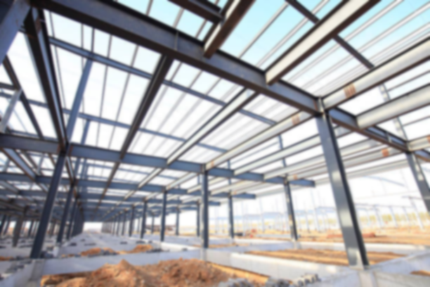
INTRODUCTION

Slide 4
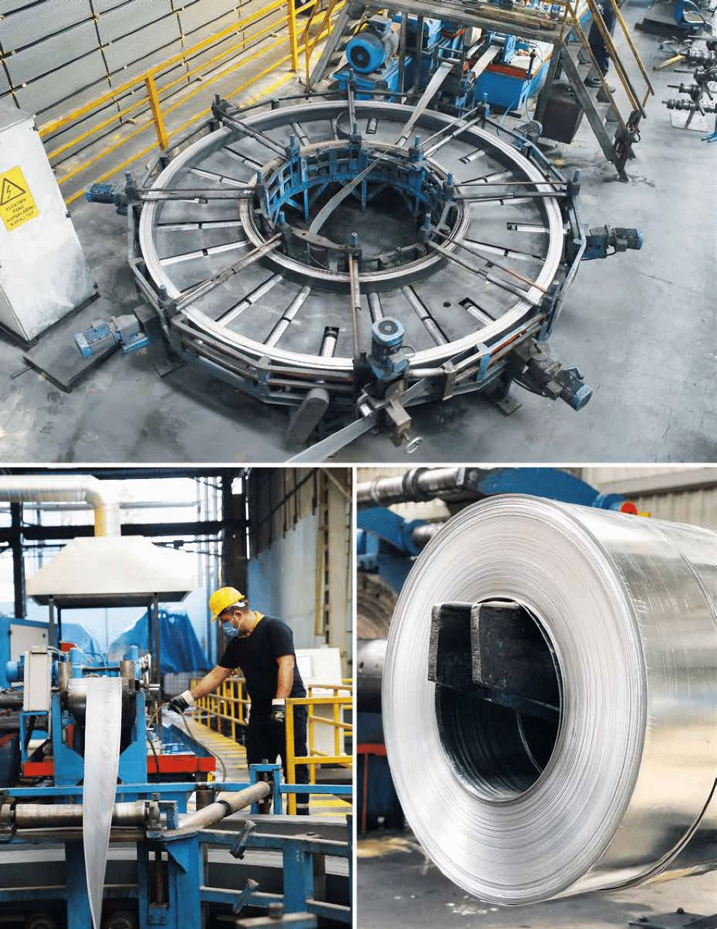
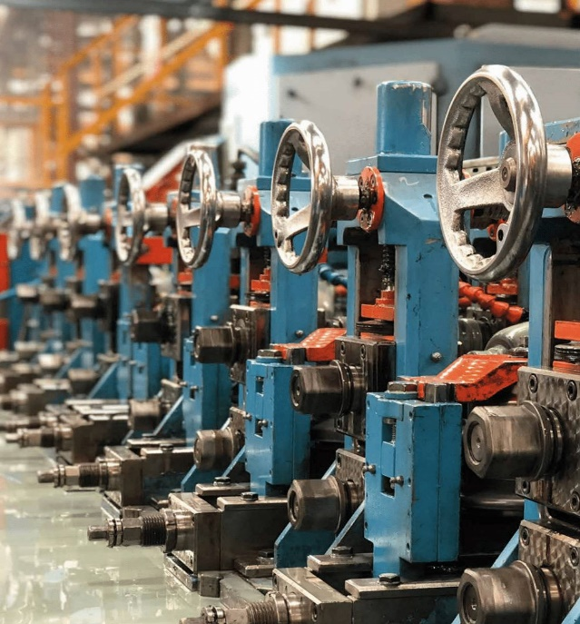
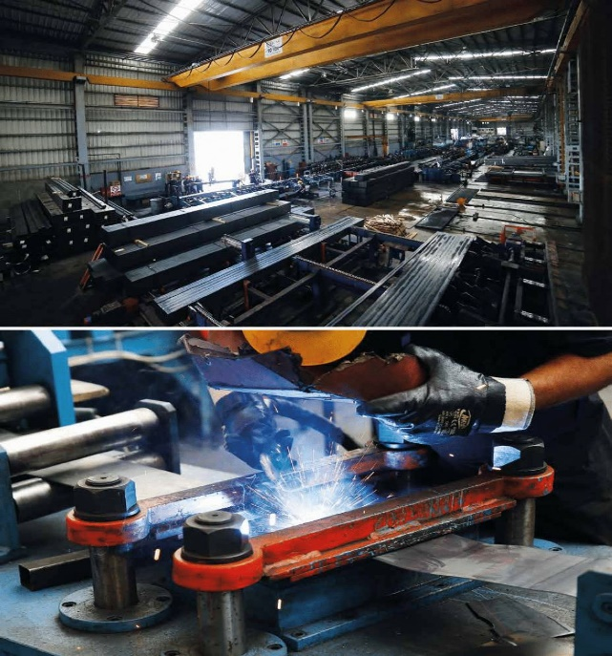
INVENTORY : The term inventory refers to the raw materials used
in production as well as the goods produced that are available for sale.

Slide 5
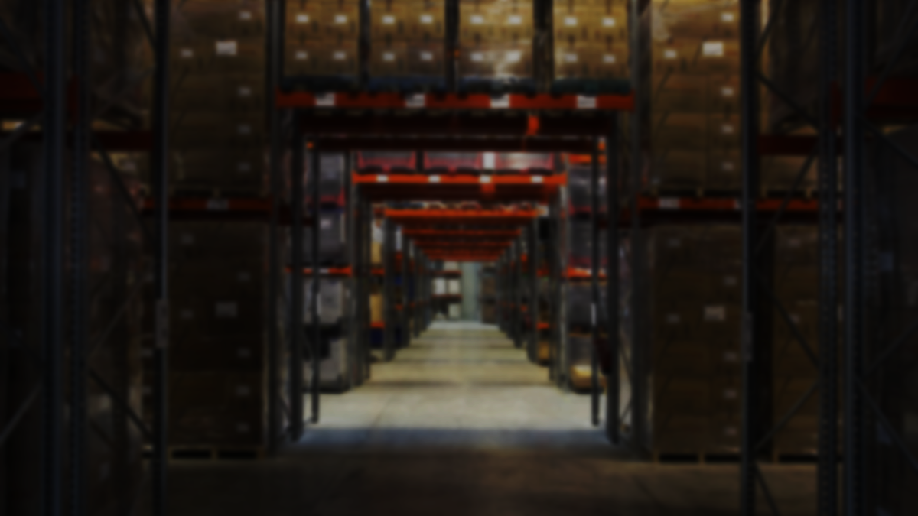
Add some text to the title slide
Inventory model :
mathematical model assists businesses in determining the ideal inventory level for their production process, managing order frequency, deciding on storage quantities, and tracking the supply flow. It aims to ensure uninterrupted service and timely delivery to customers while minimizing delays and inventory costs
with your own text
Inventory model :
mathematical model assists businesses in determining the ideal
inventory level for their production process, managing order
frequency deciding on storage quantities and tracking the supply
flow.
It aims to ensure uninterrupted service and timely delivery to
customers while minimizing delays and inventory costs with your own text

Slide 6
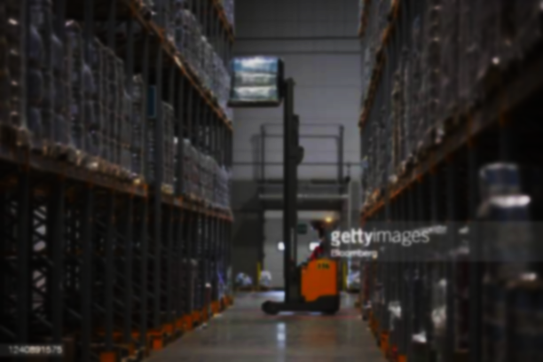
Inventory Types
(1)
Raw martial
Materials that are usually
purchased but have yet
enter the manufacturing
process.
(2)
WIP
WORK in progress
Materials that are usually
purchased but have yet entr
the manufacturing process.
(3)
finished goods
Materials that are usually
purchased but have yet entr
the manufacturing process.

Slide 7

Inventory management system need to know
How much to order
When to place an order
Models use to know how much order
EOQ
Production order quantity
ABC Analysis
Models use to know when to place order
Reorder point
Order pattern method

Slide 8
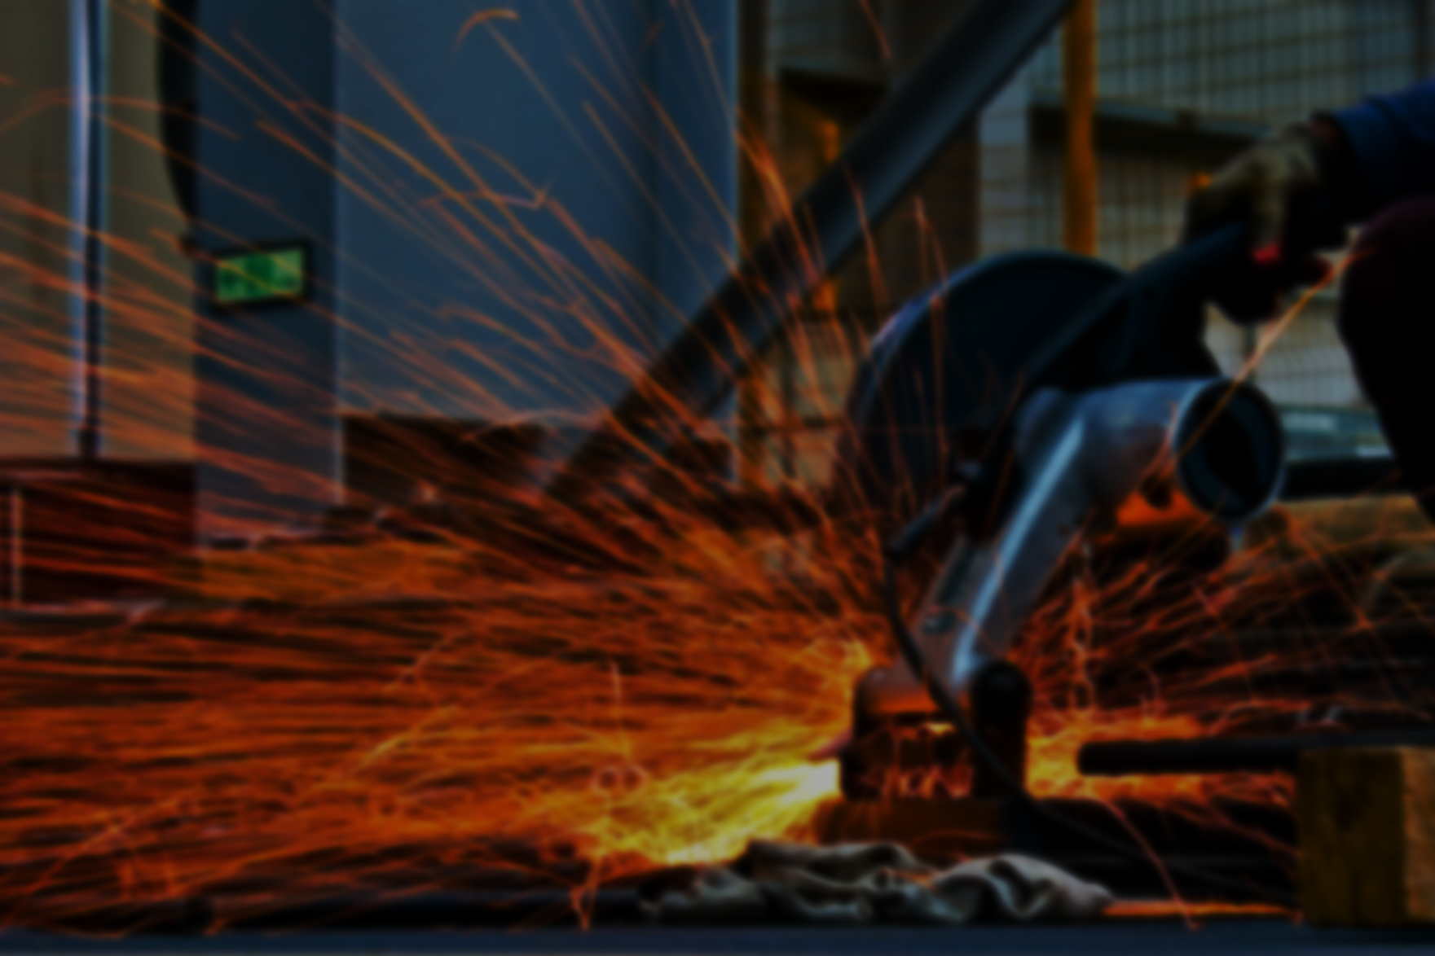


Slide 9
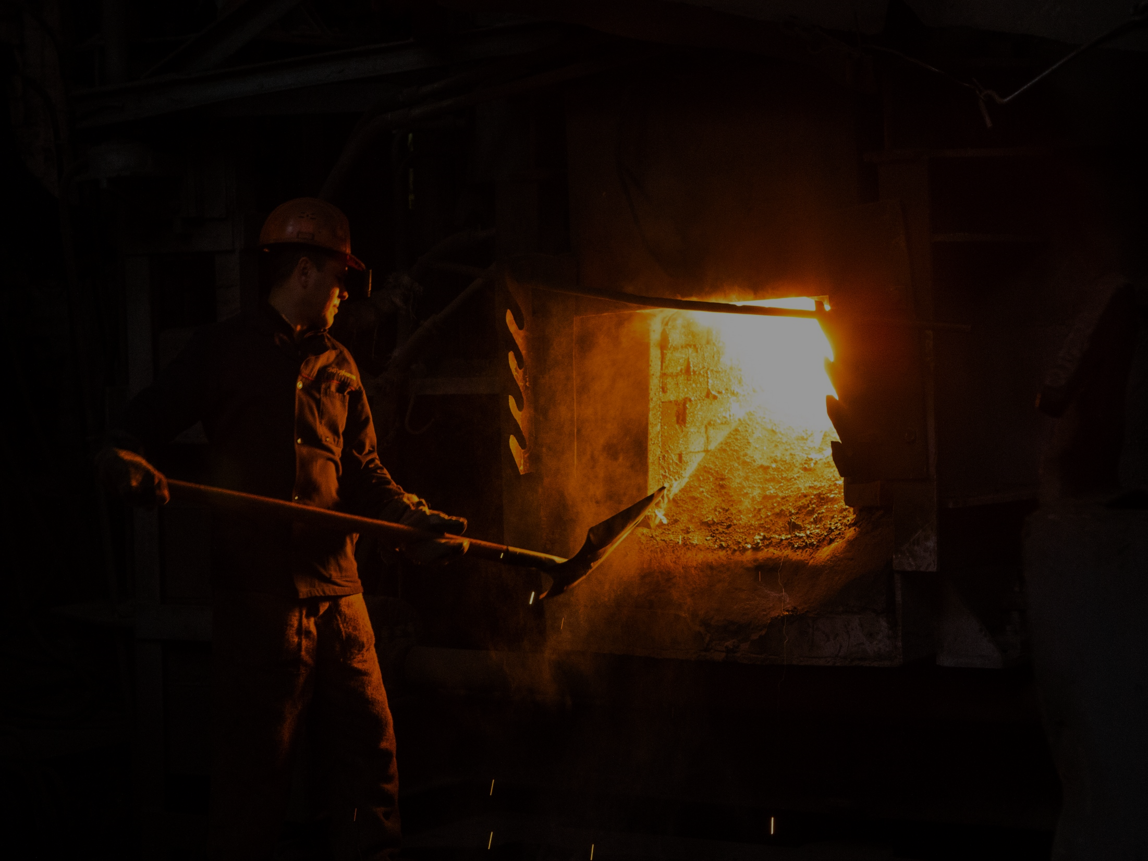
About Al ASHRY STEEL :
Established 1983, Ashry Steel Group become one of the top five steel
manufacturers/fabricators in Egypt and a well-known steel fabricator in MENA
region. Ashry Steel Group has the product mix/range from all
steel products "Steel Rebar's, Equal angles & Profiles" and also
fabrication of flat steel to produce different items "Light Step Poles,
ERW Tubes, Scaffolding, Structural towers, Cable Trays,
Light/Heavy Beams". Ashry Steel Group is one of the well known
"Steel Service Center" as any fabrication process can be executed
through Ashry Steel Group starting with studying of projects through
consultation till installation of project.

Slide 10
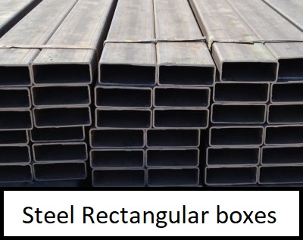
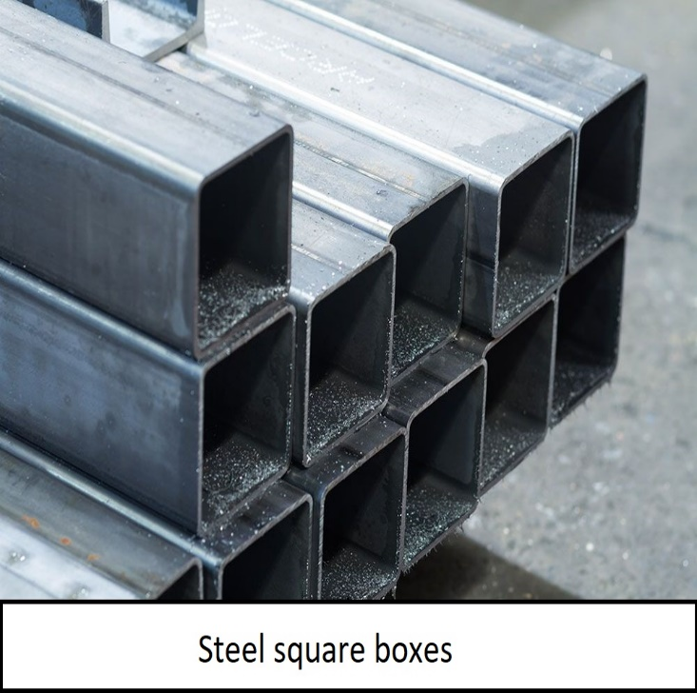
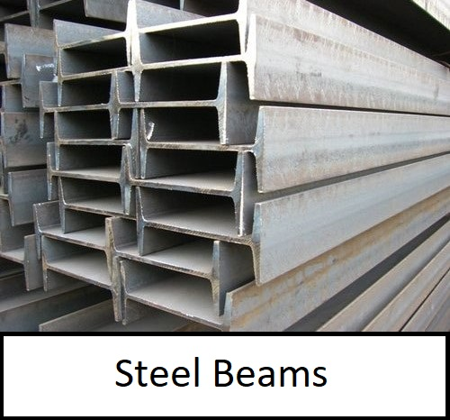
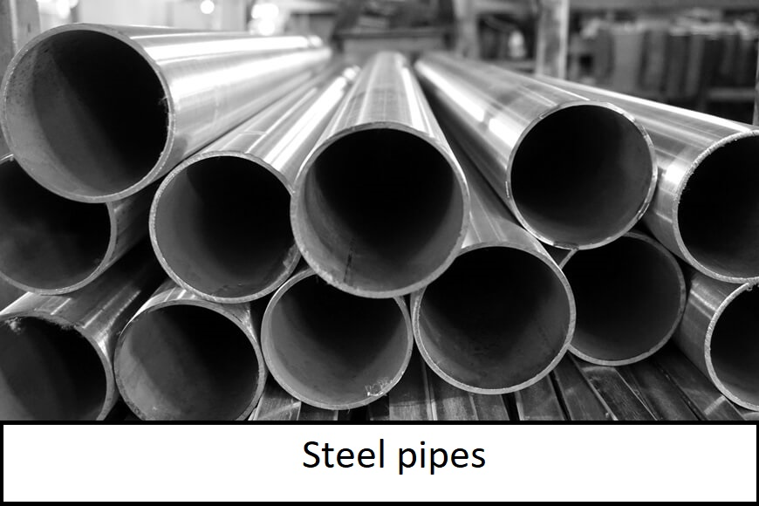
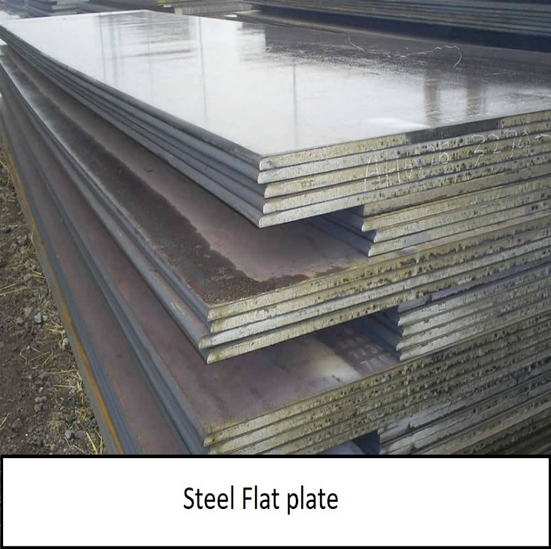
Steel Types:

Slide 11
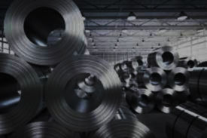
Data collection
Data collection :
We have collected the data from ERP
System of El-Ashry steel company.

Slide 12

Problems:
we found that Ashry steel make a lot of random purchases of large quantities of iron and small of percentage sales
so it costs high holding cost to the company and
it is placed in the warehouse and the company bears
a large proportion of the holding cost

Slide 13
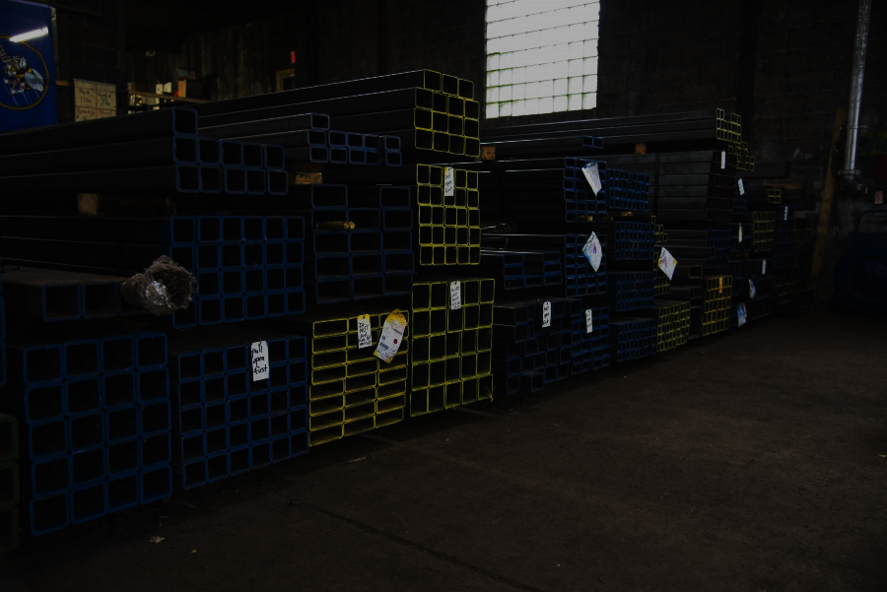
Scope
of work

Slide 14
START
Data collection
Studying Data
Data cleaning
Create new columns
Applying EOQ MODEL
END

Slide 15
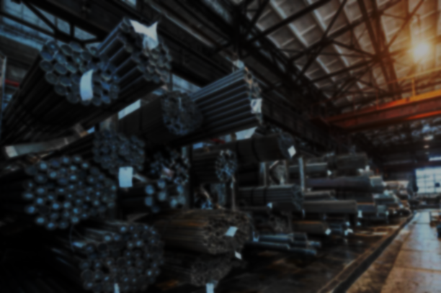
Data Preparation
Extract the Data from ERP system
Cleaned the data and remove redundant data and columns
create new column named stock = sum of purchases per month - sum of sales per month
Calculate new column total sales
Calculate new column total purchase

Slide 16
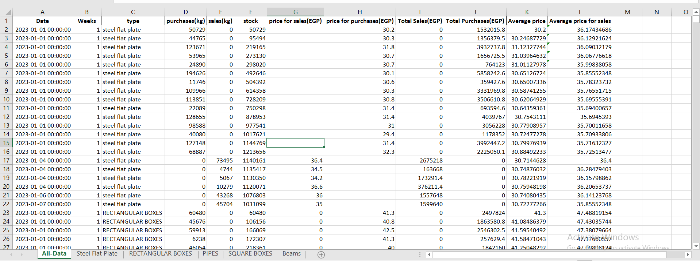
OUR Data

Slide 17
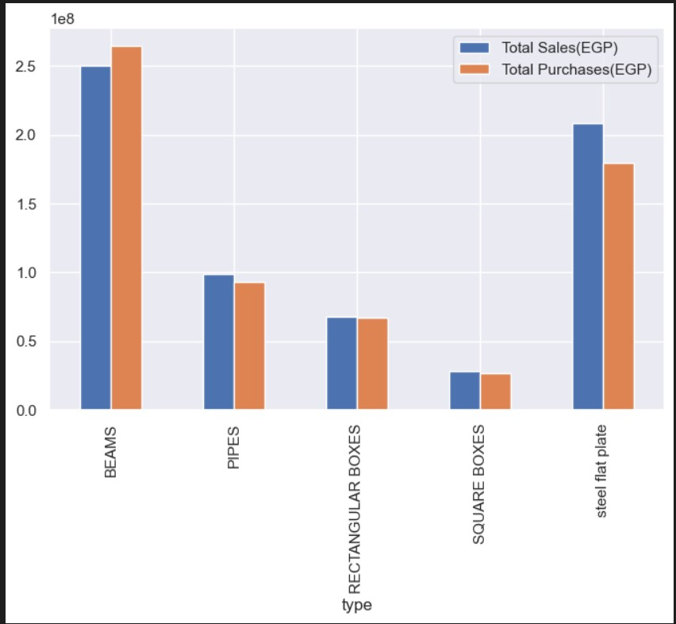
visualizations
Bar Chart For sales for every type

Slide 18
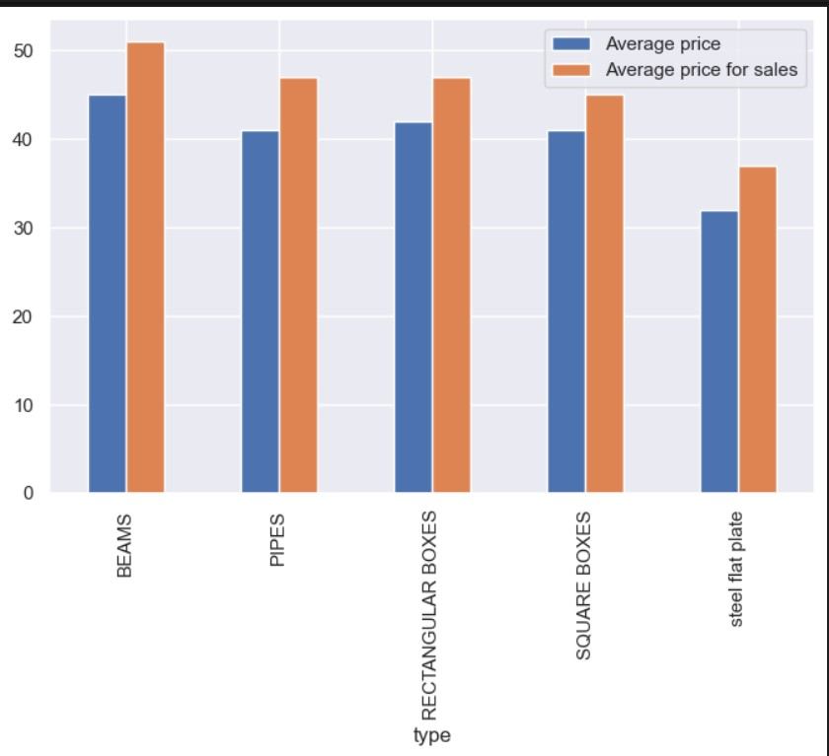
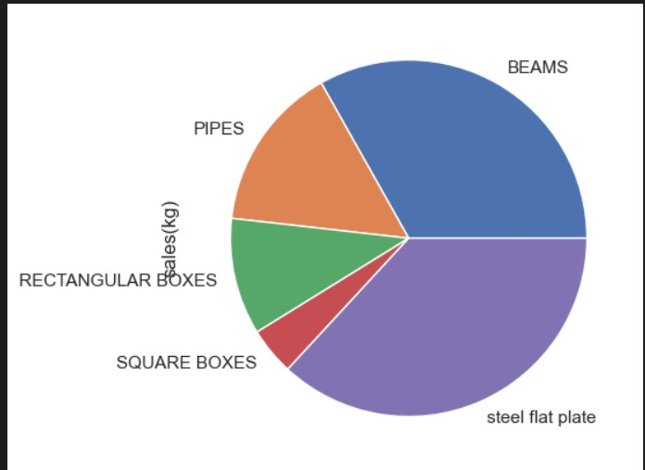
visualizations
Bar Chart For average price sales for every type
Pie Chart For e sales for every type

Slide 19
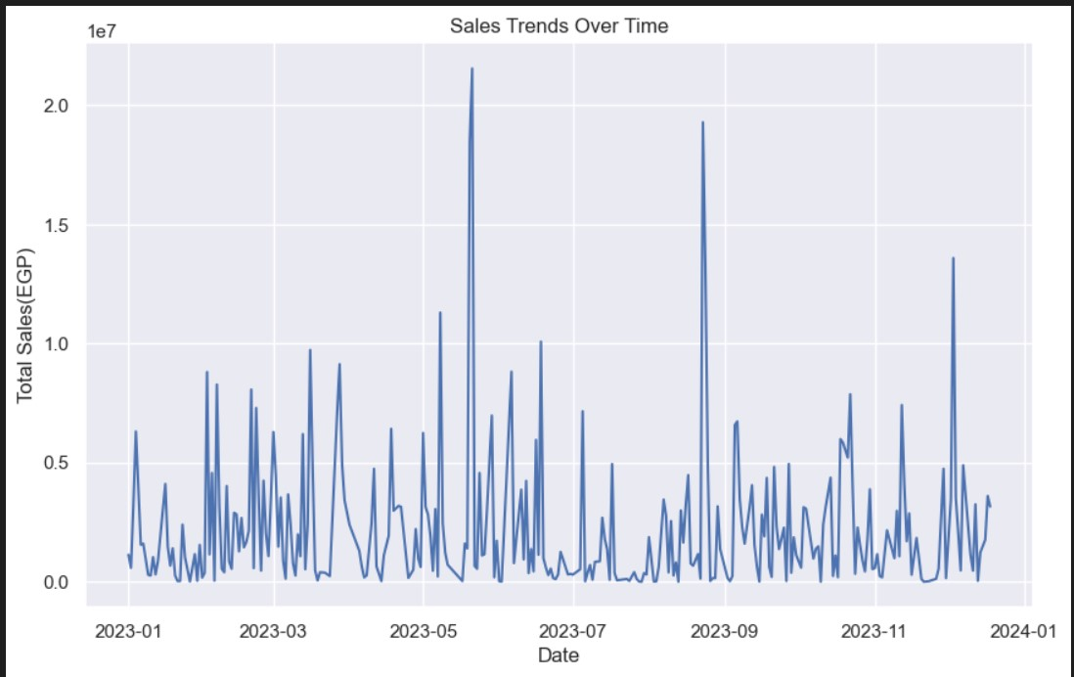
visualizations
SALES OVER TIME

Slide 20
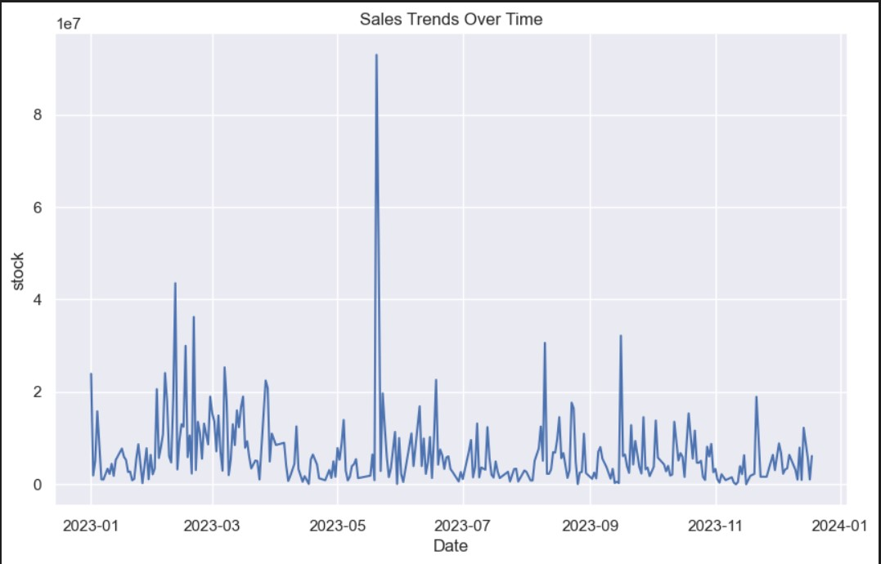
visualizations
Purchase OVER TIME

Slide 21
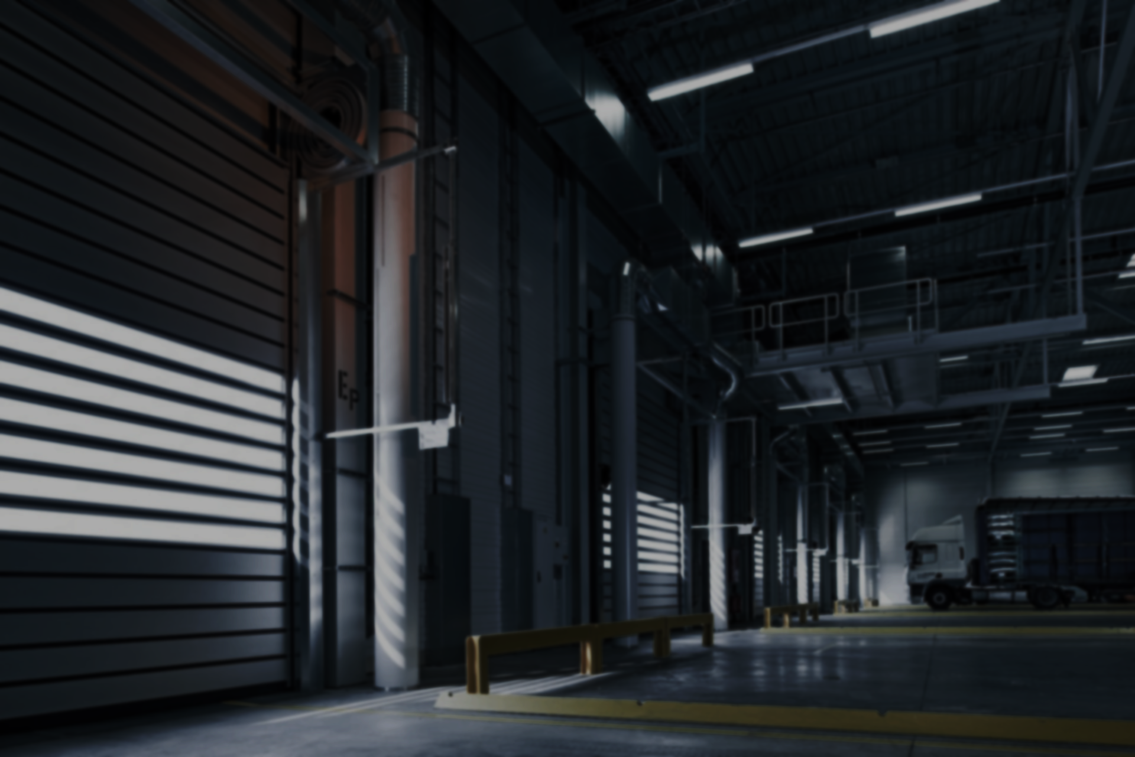
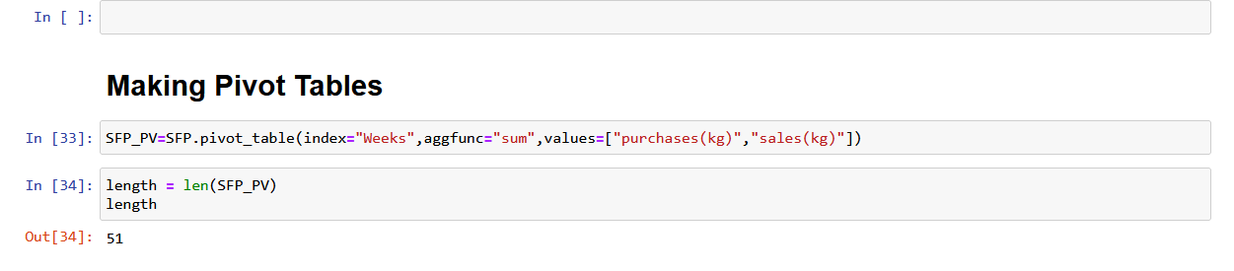
We made pivot table using python by weeks for sum of sales and purchase

Slide 22
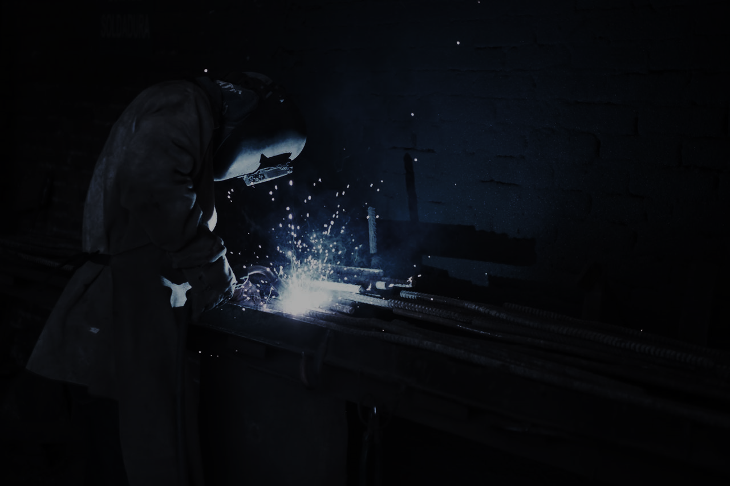
We divided the data into five types
We Calculated stock for each week
We calculated holding cost holding cost for each type
We calculated order cost for each type
= sum of purchases (kg)- sum of sales(Kg) + stock of Last week
= 0.3* (sum of purchases (kg) + sum of stock) / week
Avg-price*order-cost*sum_purchase per
week

Slide 23
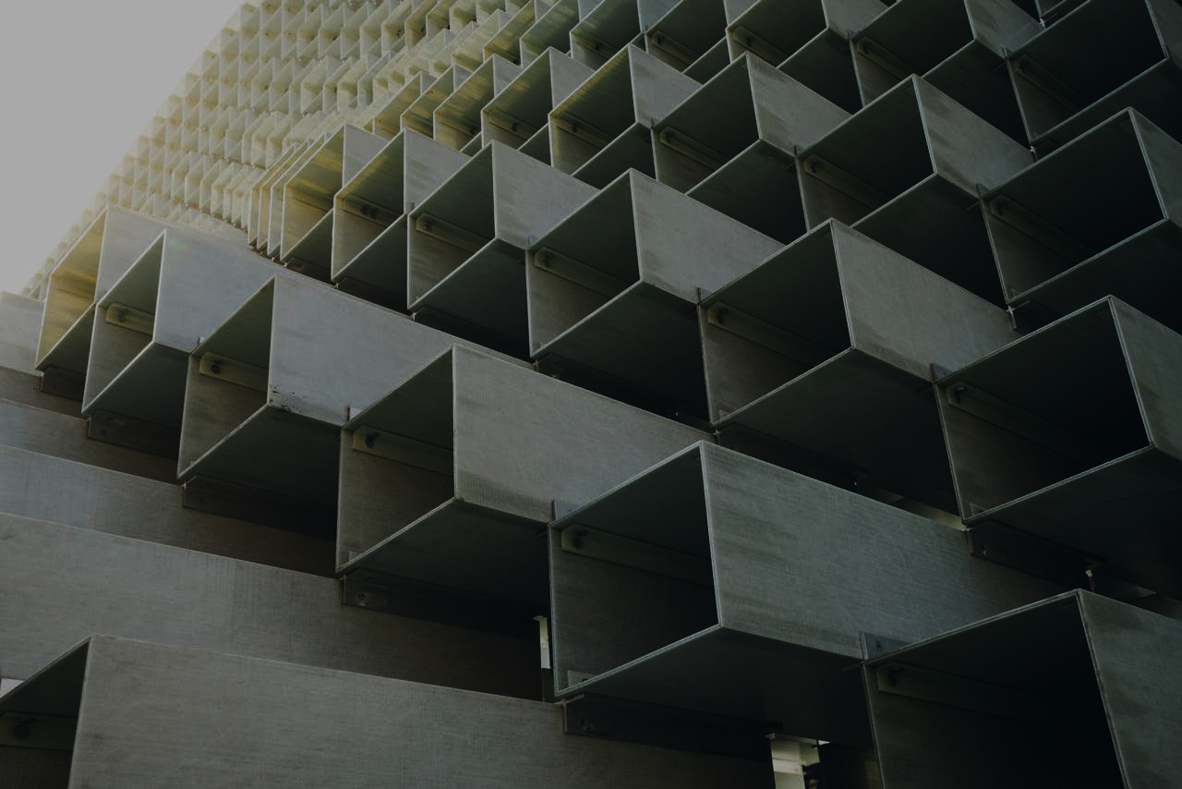
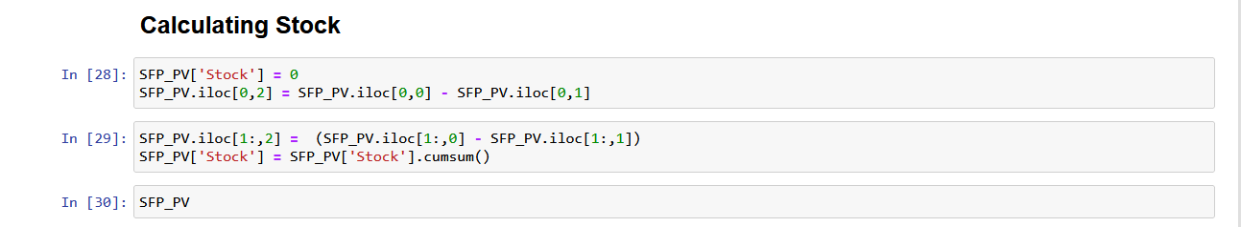
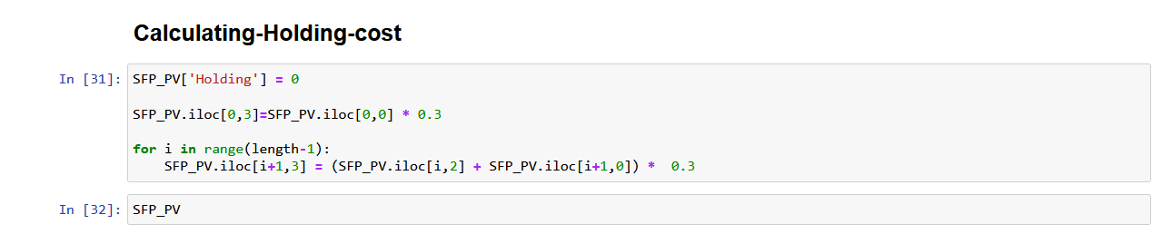
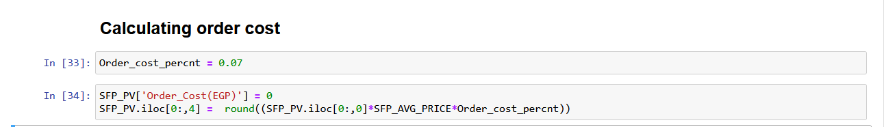

Slide 24

EOQ MODEL
Implementation

Slide 25

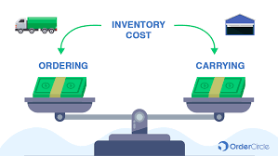
EOQ Inventory Model
We used Economic order quantity (EOQ) to get the optimal quantity to Purchase.

Slide 26
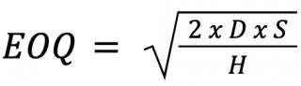
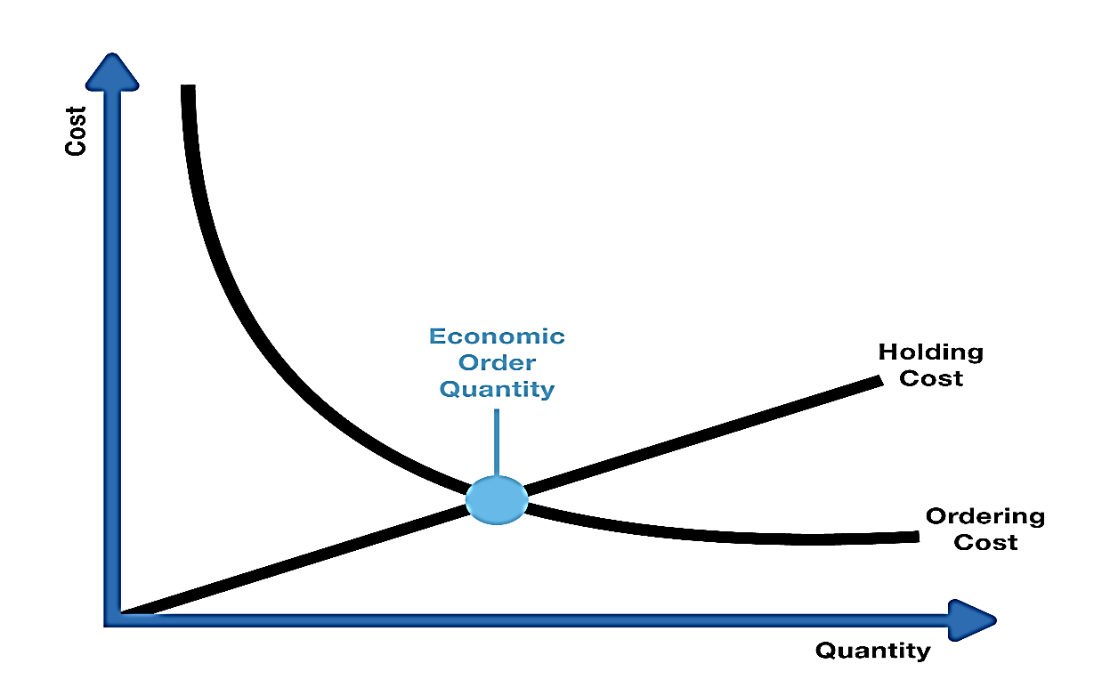
EOQ Formula
D = Annual demand
S = Setup Cost
H = holding cost per unit

Slide 27

Steps :
We calculated average order quantity for each type
2) We calculated average Price for each type
3)We calculated total order cost for each type * ORDER_COST
4) We calculated average price for sales for each type
5) We calculated annual sales for each type

Slide 28
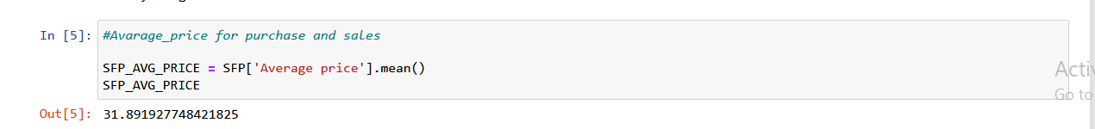
We calculated average price for purchase for every type
Steel-flat-plate = 31.89
RECTANGULAR BOXES =41.58242458529777
SQUARE BOXES = 41.371621372307104
BEAMS = 45.27848585763299
PIPES = 41.28665747264758

Slide 29
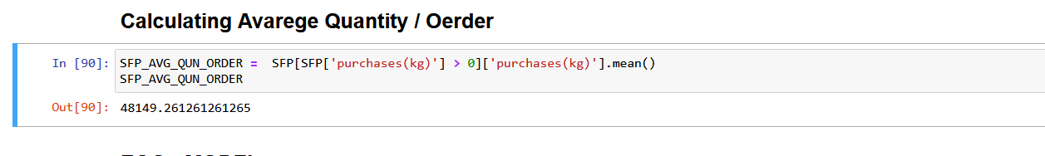
We calculated average order quantity for every type
Steel-flat-plate = 48149.261261261265
RECTANGULAR BOXES =19354.21686746988
SQUARE BOXES =22221.58620689655
BEAMS =20916.91605839416
PIPES =8922.782258064517

Slide 30
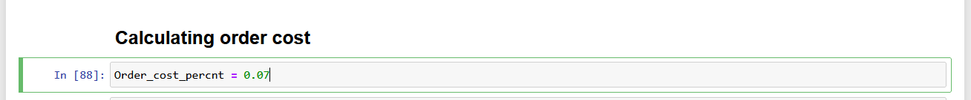
We calculated fixed cost for placing an order for every type
Steel-flat-plate = 107490.09328988213
RECTANGULAR BOXES = 56335.66843093451
SQUARE BOXES = 64354.01
BEAMS = = 66296.040
PIPES =25787.42

Slide 31
We calculated average price for sales for every type
Steel-flat-plate = 37.7
RECTANGULAR BOXES =47.0142458529777
SQUARE BOXES = 45.171621372307104
BEAMS = 51.07848585763299
PIPES = 47.0086657472

Slide 32
Calculate Sum annual sales each type
Steel-flat-plate = 533218
RECTANGULAR BOXES = 1533186
SQUARE BOXES = 624600
BEAMS = 4796791
PIPES = 2176813

Slide 33

IMPLEMENT
ON DATA

Slide 34
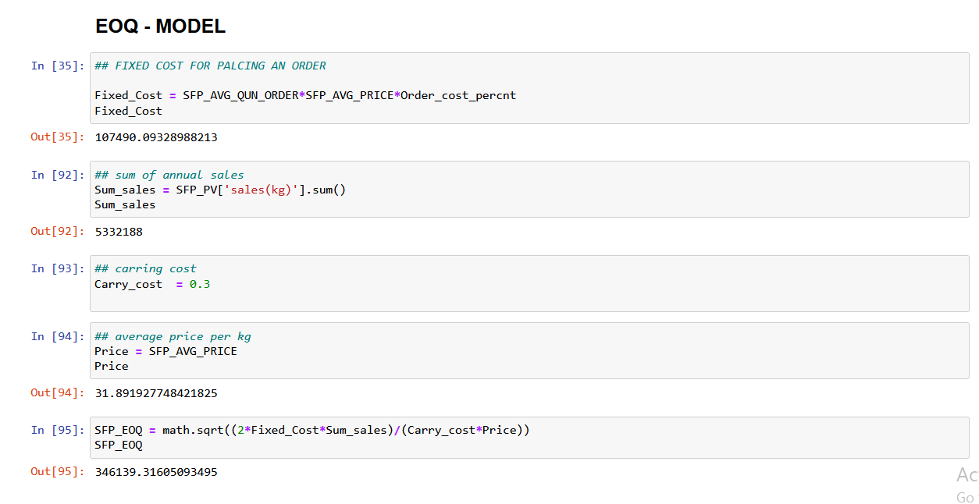
Steel flat plate :

Slide 35
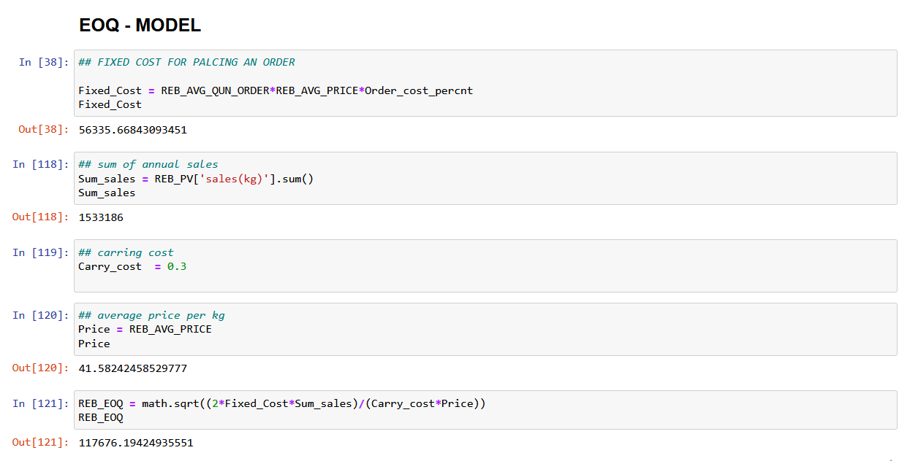
RECTANGULAR BOXES :

Slide 36
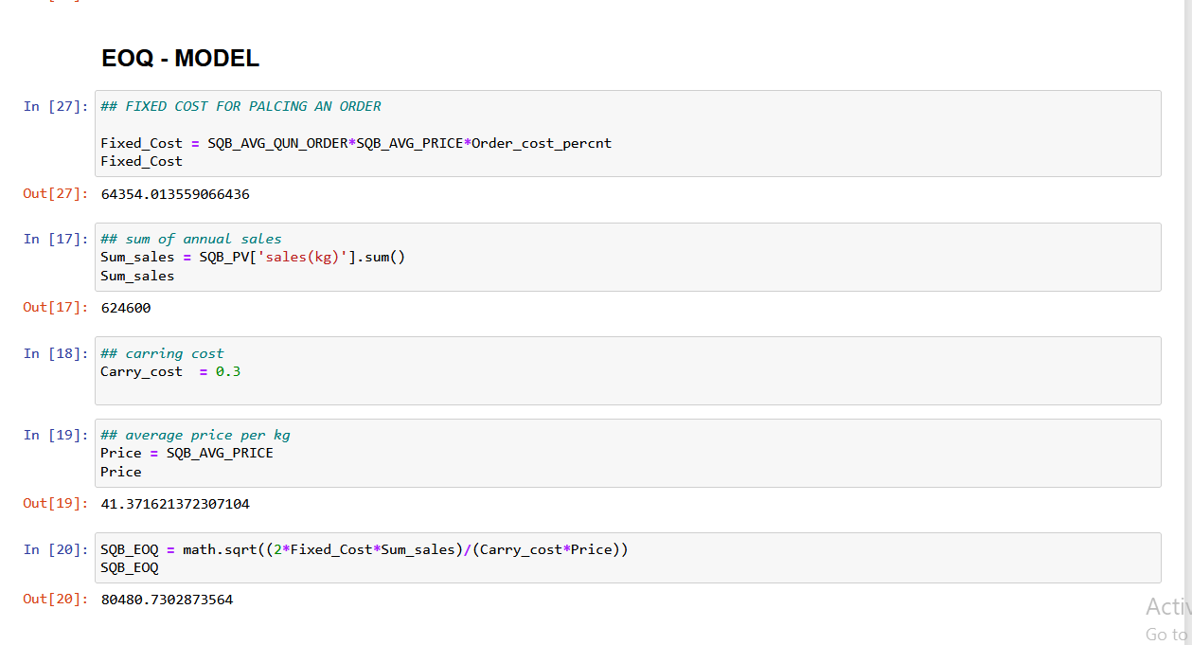
SQUARE BOXES :

Slide 37
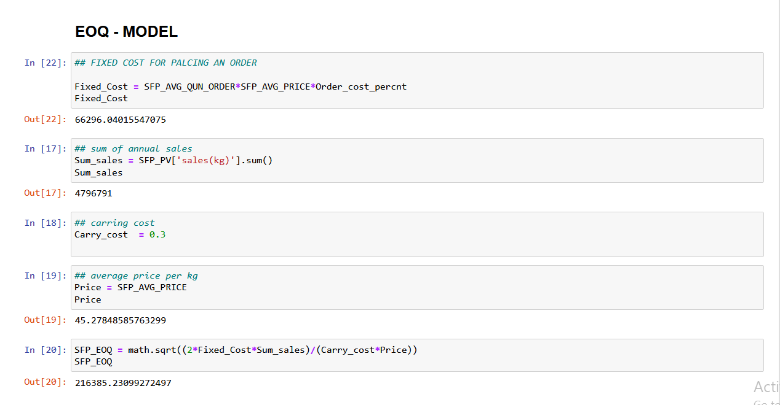
BEAMS :

Slide 38
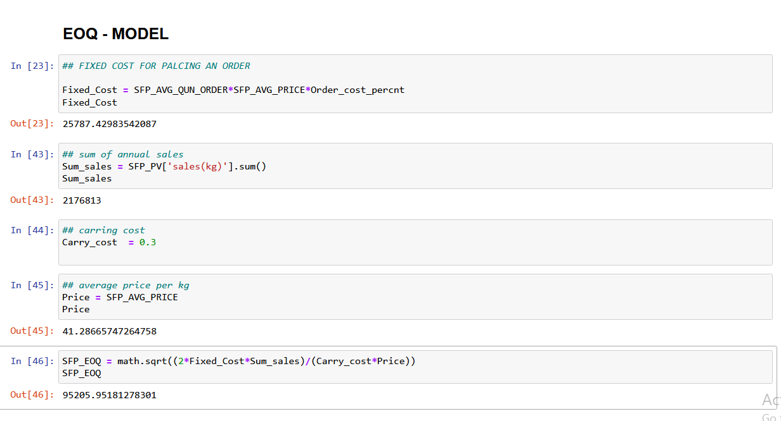
PIPES :

Slide 39
Calculated the EOQ for each Type using formula of EOQ
EOQ of Steel-flat-plate= 346139.3160
EOQ of Rectangle boxes= 117676.19424
EOQ of Square boxes = 80480.7302
EOQ of Beams= 216385.2309
EOQ of PIPES = 95205.951

Slide 40

Calculate the Reorder Point using ROP formula
Lead time = 3
Weakly average sales = sum sales / weeks(number)
Re-order-point = Lead time * Weakly average sales

Slide 41
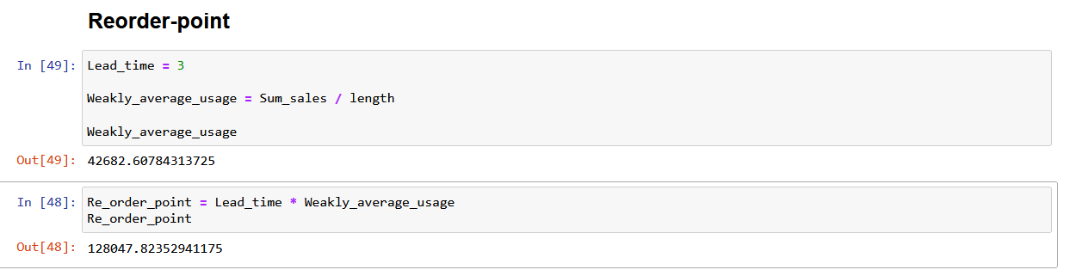
Calculate Re-order-point for each type

Slide 42
Calculated the ROP for each Type using formula of ROP
ROP of Steel-flat-plate= 313658.1176470
ROP of Rectangle boxes= 99990.3913043
ROP of Square boxes = 60445.161290
ROP of Beams= 282164.17647058825
ROP of PIPES = 128047.82352941175

Slide 43
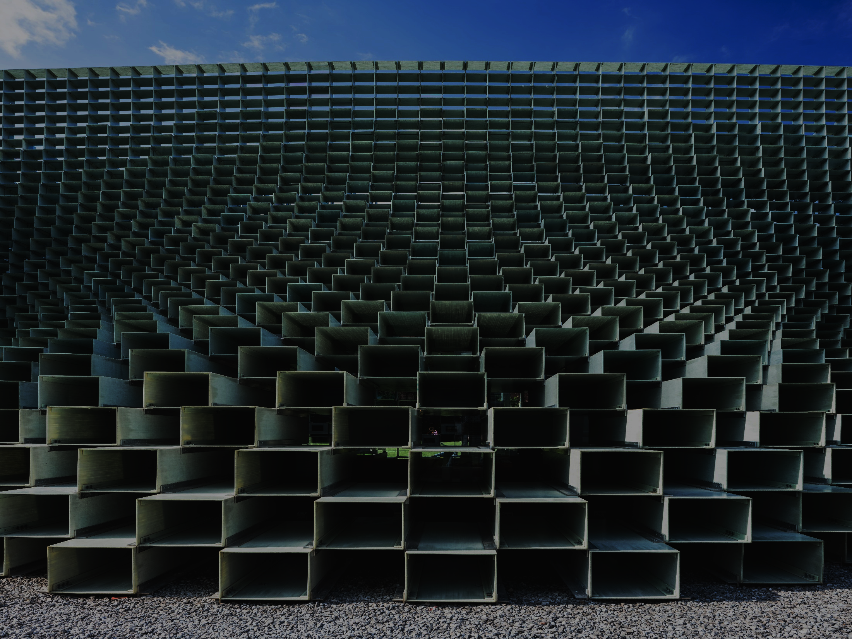
Calculating PURCHASE EOQ and New-stock
New Holding cost and order cost

Slide 44
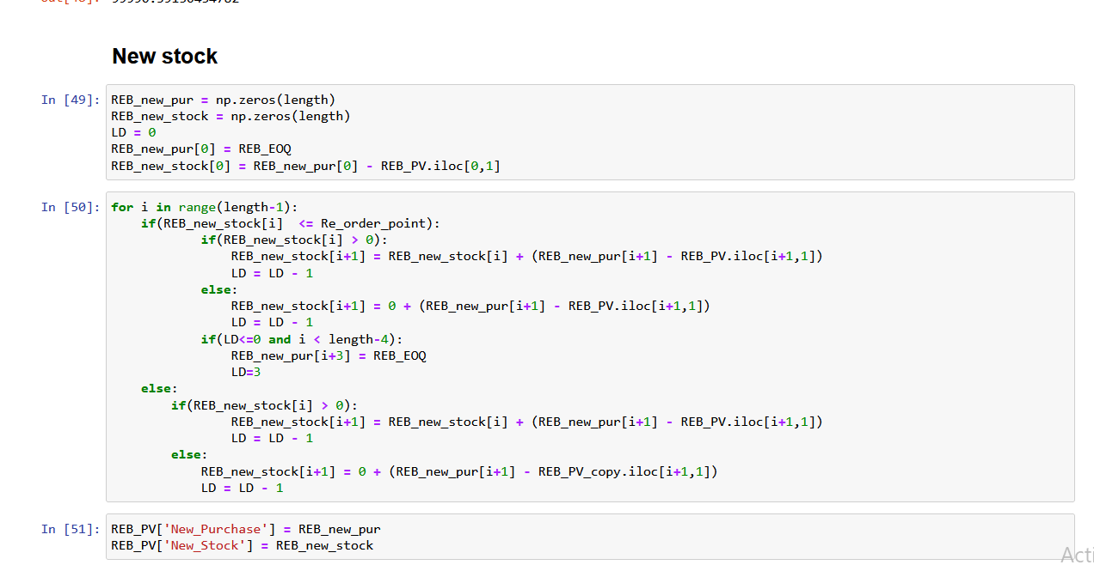
Calculating Purchase EOQ and New-stock
Steel-flat-plate = 37.7
RECTANGULAR BOXES =47.0142458529777
SQUARE BOXES = 45.171621372307104
BEAMS = 51.07848585763299
PIPES = 47.0086657472

Slide 45
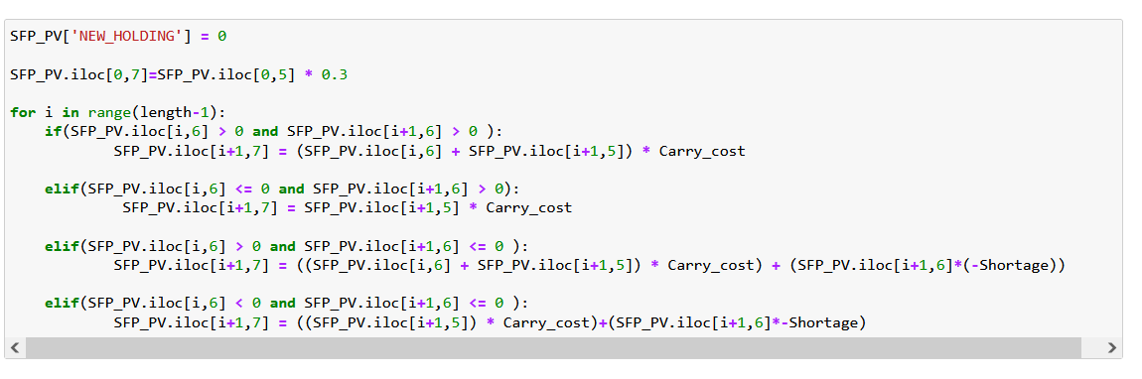
Calculating New Holding cost
Steel-flat-plate = 37.7
RECTANGULAR BOXES =47.0142458529777
SQUARE BOXES = 45.171621372307104
BEAMS = 51.07848585763299
PIPES = 47.0086657472

Slide 46
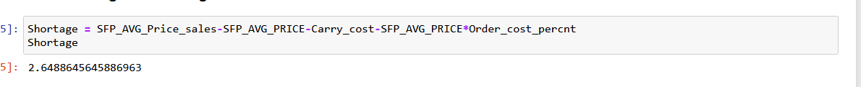
Calculate shortage cost per unit for each type
Steel-flat-plate = 2.6
RECTANGULAR BOXES =2.215
SQUARE BOXES = 2.33
BEAMS =1.67
PIPES =2.53

Slide 47
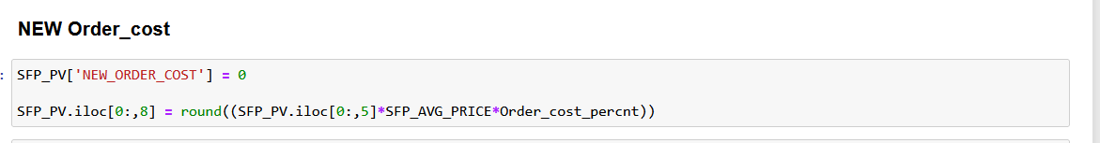
Calculating New ordering cost

Slide 48
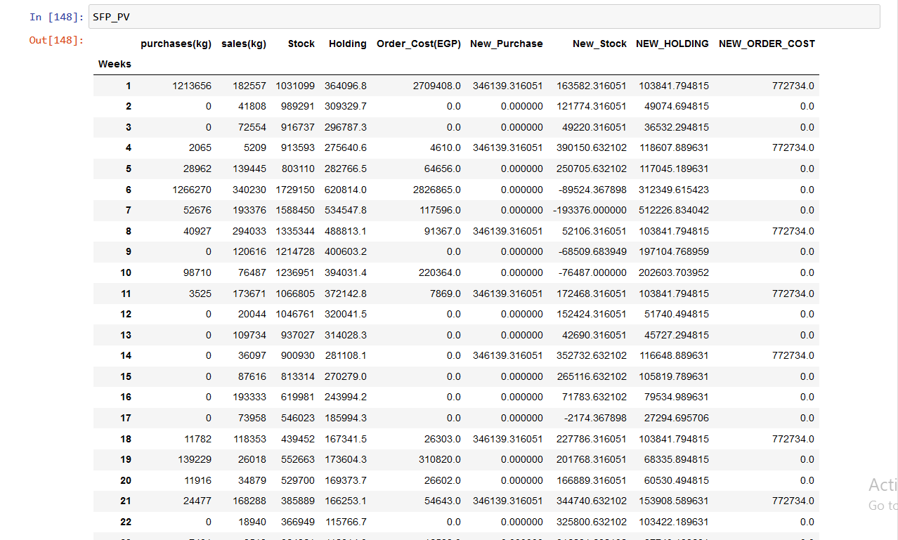

Slide 49

CALCULATING Total Cost Before and After EOQ
Total-cost-before-EOQ=sum of holding cost + sum of order cost
Total-cost-after-EOQ = sum of holding cost + sum of order cost

Slide 50
We calculated total cost before EOQ for every type
Steel-flat-plate = 26840189
RECTANGULAR BOXES =10231224
SQUARE BOXES = 3049488.599
BEAMS = 39703570.59
PIPES = 10204658.8

Slide 51
We calculated total cost after EOQ for every type
Steel-flat-plate = 7334924.2
RECTANGULAR BOXES =5575068.3
SQUARE BOXES = 2301927.893
BEAMS = 16704879
PIPES = 7334924.287854968

Slide 52
Calculated the saving for each type
ROP of Steel-flat-plate = 10807433.5577
ROP of Rectangle boxes = 4656155.93175
ROP of Square boxes = 747560.7060287
ROP of Beams = 22998691
ROP of PIPES = 128047.82352

Slide 53

Results on
visualizations

Slide 54
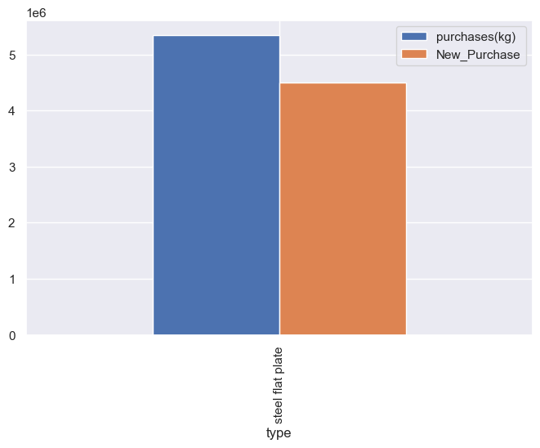
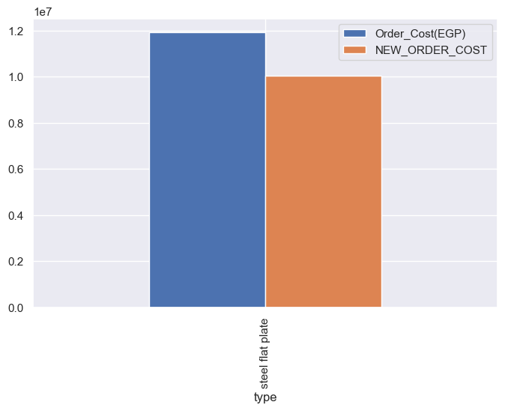
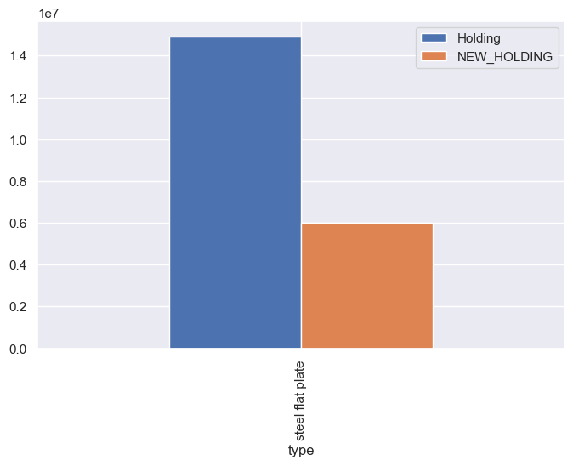
Steel flat plate
Purchases and new purchase
Old order and new order cost
Old Holding new Hodling

Slide 55

Steel flat plate
Old Stock and new stock over time

Slide 56

Steel flat plate
Old holding cost and new holding cost over time

Slide 57


SQUARE BOXES
Purchases and new purchase
Old order and new order cost
Old Holding new Hodling

Slide 58

SQUARE BOXES
Old Stock and new stock over time

Slide 59

SQUARE BOXES
Old holding cost and new holding cost over time

Slide 60



RECTANGULAR BOXES
Purchases and new purchase
Old order and new order cost
Old Holding new Hodling

Slide 61

RECTANGULAR BOXES
Old Stock and new stock over time

Slide 62

RECTANGULAR BOXES
Old Holding and new Holding over time

Slide 63



PIPES
Purchases and new purchase
Old order and new order cost
Old Holding new Hodling

Slide 64

PIPES
Old Stock and new stock over time

Slide 65

PIPES
Old Holding and new Holding over time

Slide 66



Beams
Purchases and new purchase
Old order and new order cost
Old Holding new Hodling

Slide 67

Beams
Old Stock and new stock over time

Slide 68

Beams
Old Holding and new Holding over time

Slide 69
Names
Youssef Emad Hussin Abo Rawash
Amr Ahmed Ahmed Mohmed
Mohmed Hazem Ammar
Zinab Mohy El-Din Mohmed

Slide 70
THANK YOU

